Slide 1
i.Center Makerspace Floor Plan
Level 1, 4, 5, and 6 of Lee Shau Kee Sci. & Tech Bldg
Nov 7, 2015

Slide 2
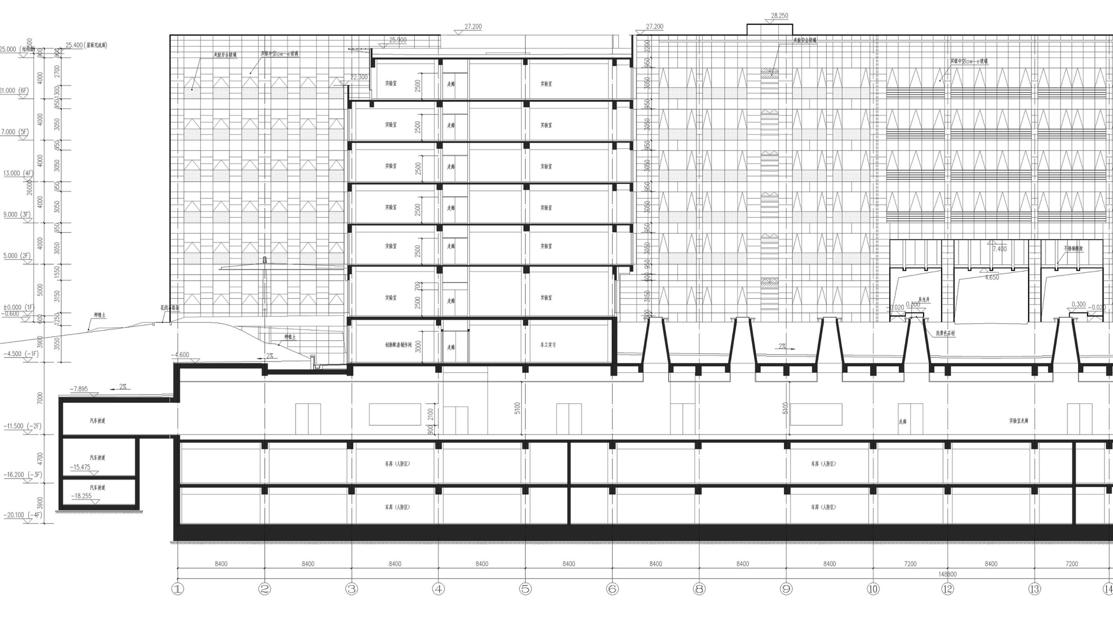
i.Center Floor Plan
6F
5F
4F
3F
2F
1F
B1
B2
B3
B4
Ball room
Startup teams
Video conferencing
N
W
E
Fast prototyping
Trans-disciplinary workshops
S
Electornics labs
Student hobby clubs
Managerial and executive floor
Benchwork, electronics labs
Team building and training labs
The Maker Café
Advanced manufacturing labs
Welding, material processing labs
The Large Workshop,
with scores of conventional and CNC machining tools
Garage
Lost-die casting

Slide 3
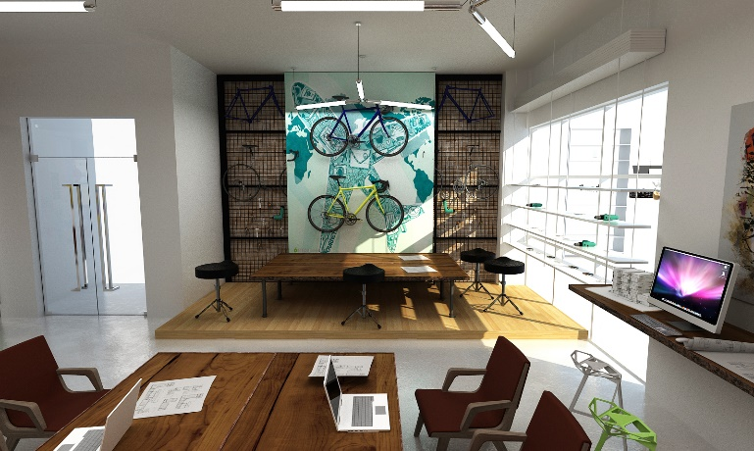
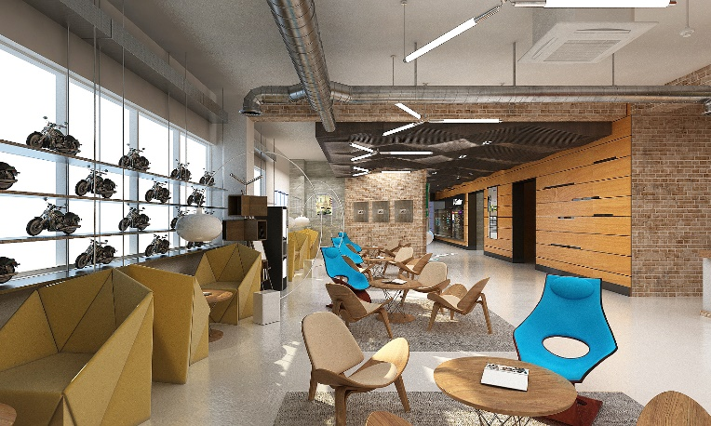
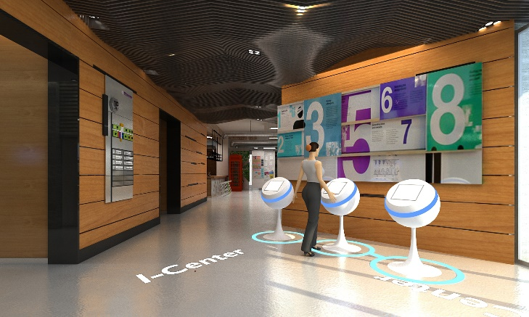
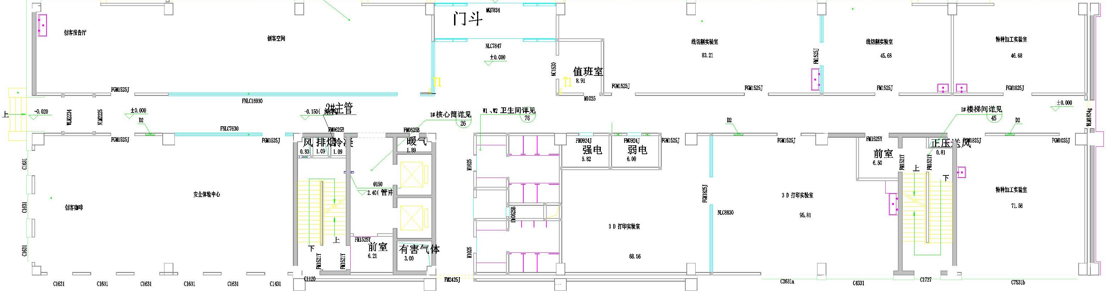
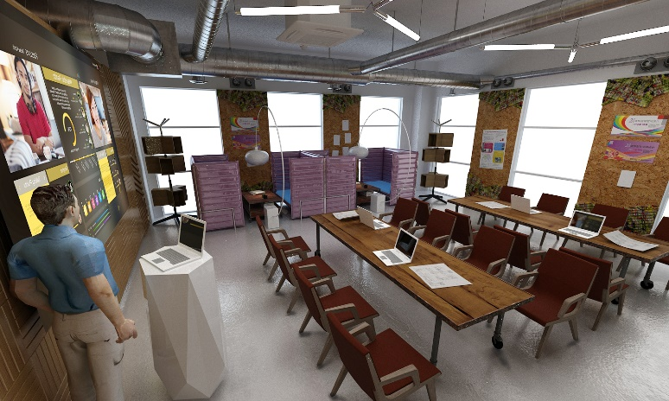
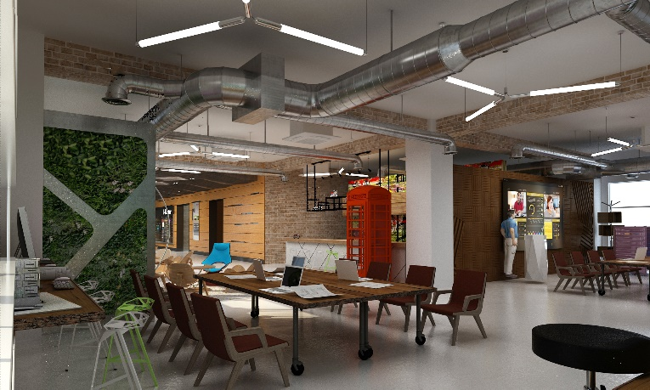
1st floor
Tsinghua student bike club
The Maker Café
Advanced manufacturing labs
(3D printing, electric wire cutting,
laser cutting, 3D scanning, etc.)
Bike club
The Maker Café
‘Wu Tong’
i.Center mentors for maker
Courses

Slide 4
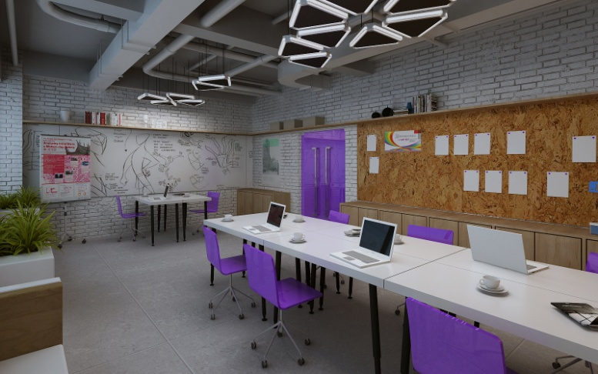
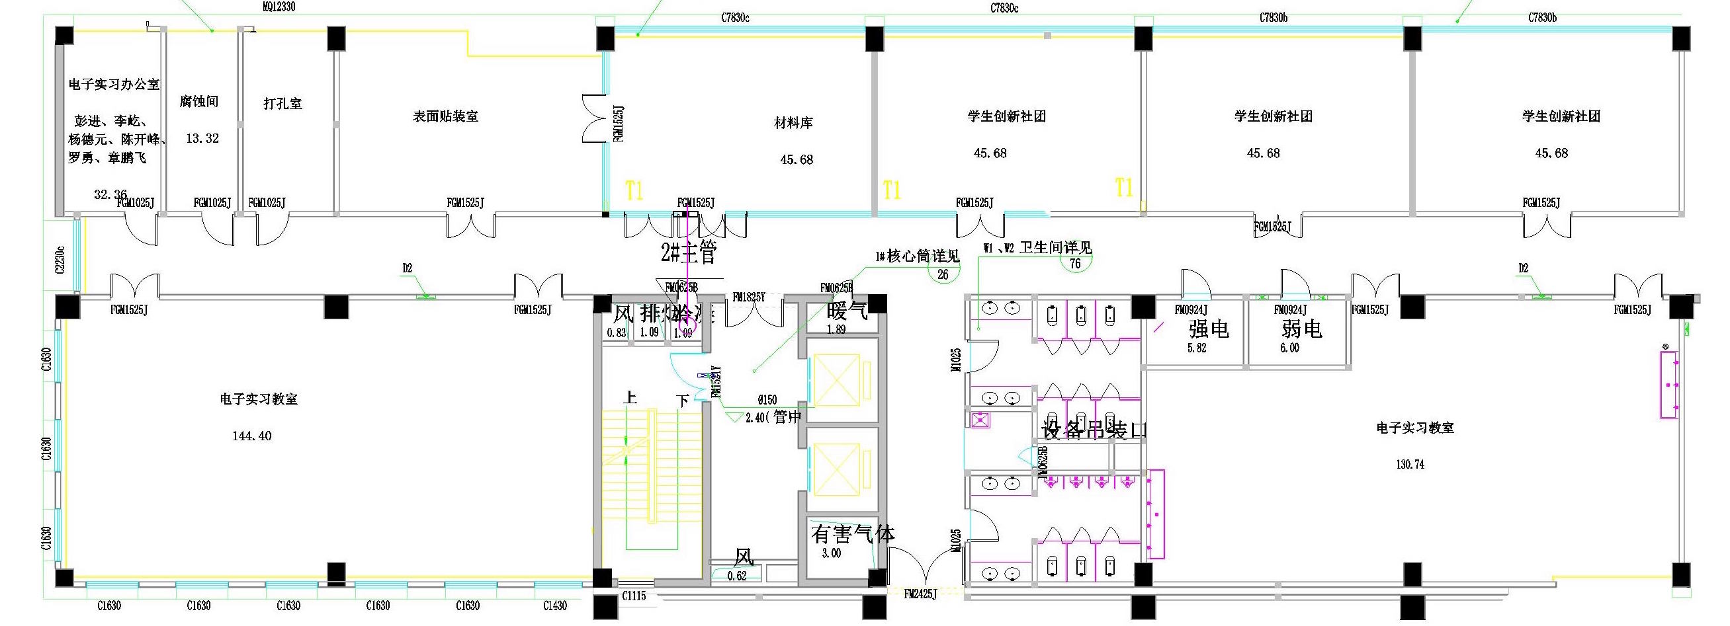
4th floor
Student hobby clubs

Slide 5
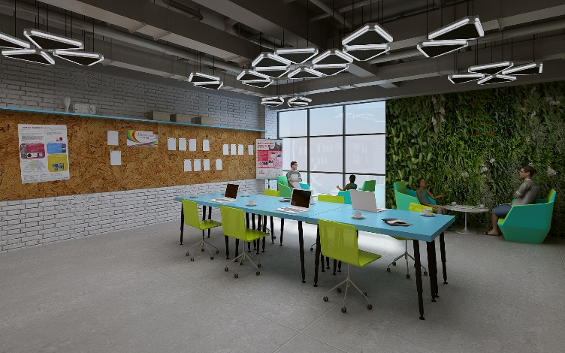
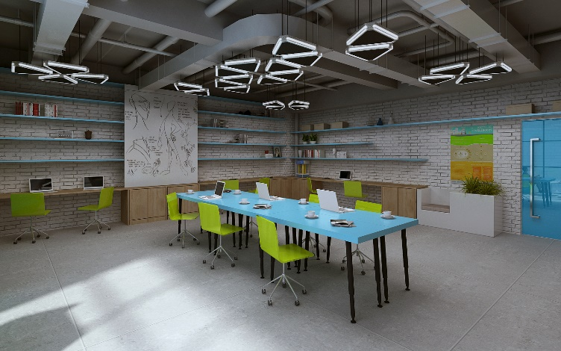
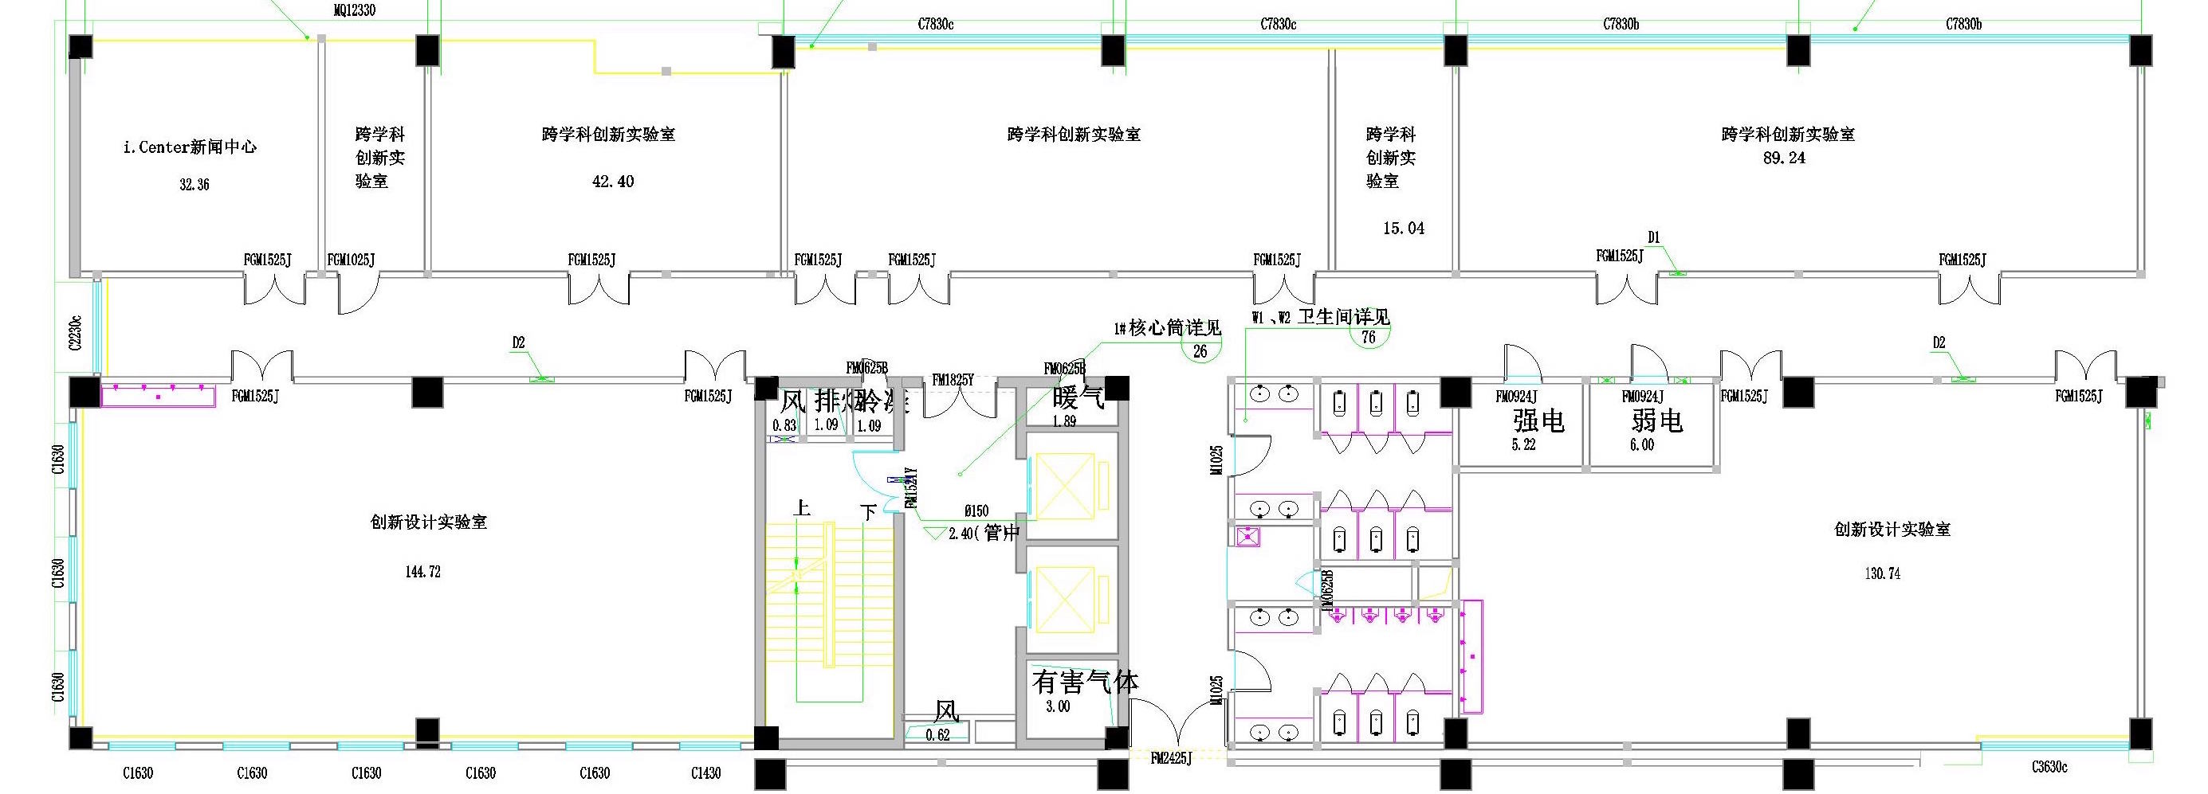
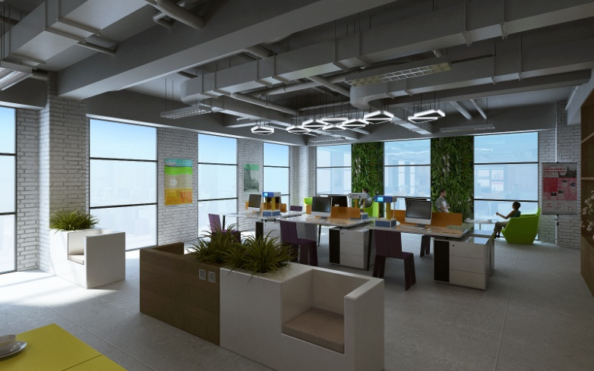
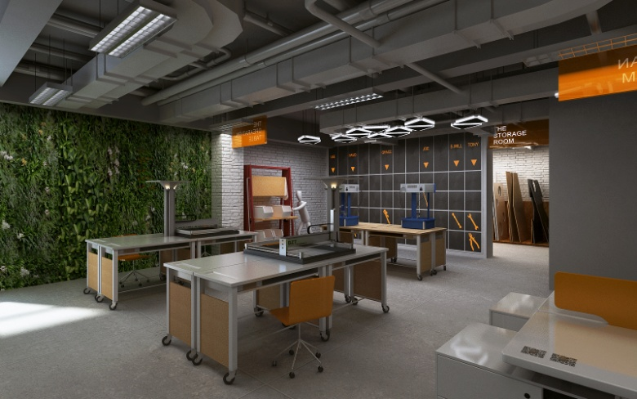
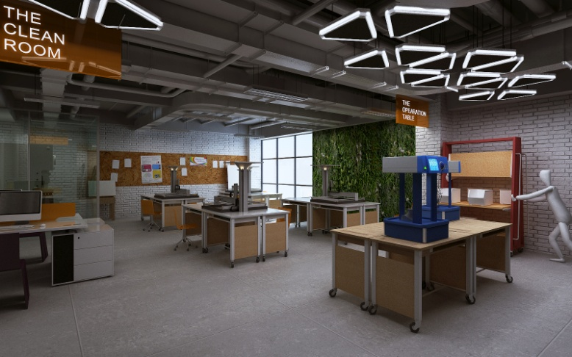
5th floor
Consultant
Prof.
Office
i.Center
Media Center
Trans-disciplinary workshops
Open design studio
‘Xian Ju’
Fast prototyping workshop
‘Yan Ming’
Hackers in residence
Dream realization funds

Slide 6
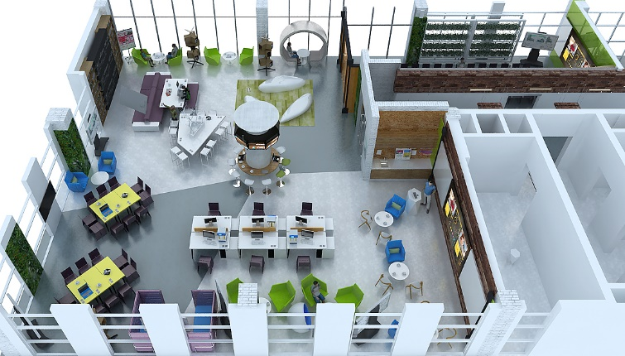
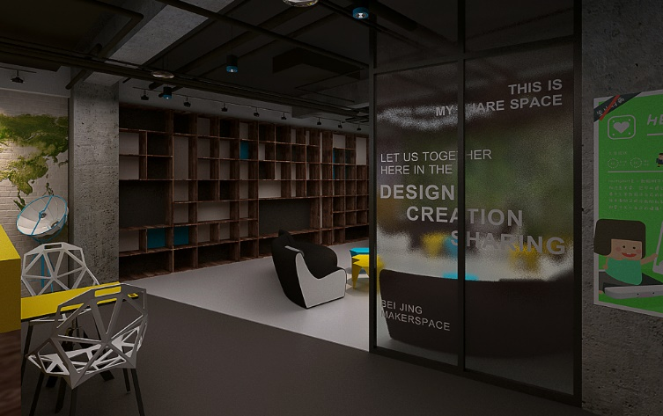
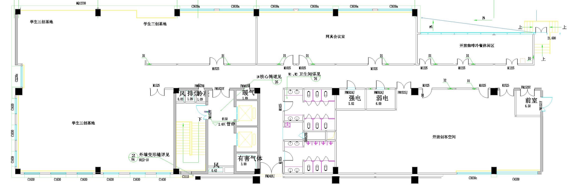
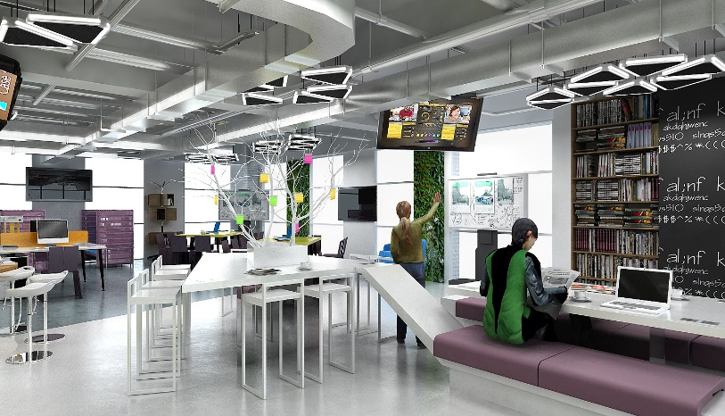
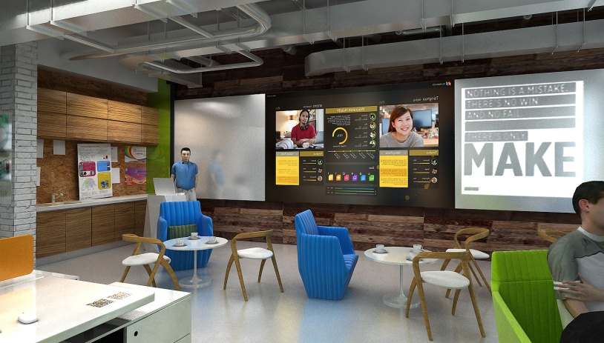
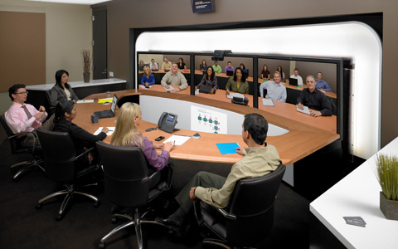



6th floor
TEDxTHU, Student Maker Community,
Micro-Making, Lab μ Geeks Club……
Dream realization funds
Tsinghua Student Tea Culture Community
Ball room
Function room
‘Chun Hua’
Prep room
Consultant
Student startups
‘Qiu Shi’
Tea house
Video con
‘Yan Qi’
E-classroom
MOOC
Industry 4.5 Forum, Hackers in Residence Forum,
Maker and Education Forum, hackathons, etc.
Video conferencing

